Slide 1




Modeling Terrain Visibility from a Point
Line of Sight and Viewshed
Matthew Camarena, Shrinithi Kalai, Ye Lim Koo, Brayden Nicholl
Dec 9, 2019
Math 370, CSUF

Slide 2
Developing a Simple model for line of sight
Defining line of sight
Demonstrating visually and graphically using an example
Creating an equation
Connecting the example to terrain data
Notes:
https://www.researchgate.net/figure/Visibility-queries-using-a-line-of-sight_fig1_268445263

Slide 3
What is line of sight?
A line from an observer's eye to a distant visible point
The line between two points specifically : the straight path between a transmitting antenna (as for radio or television signals) and a receiving antenna when unobstructed by the horizon
Notes:
Or from definition https://gisgeography.com/line-of-sight-viewshed-visibility-analysis/
OR http://www.gitta.info/TerrainAnalyi/en/html/VisibilAppls_learningObject2.xhtml

Slide 4
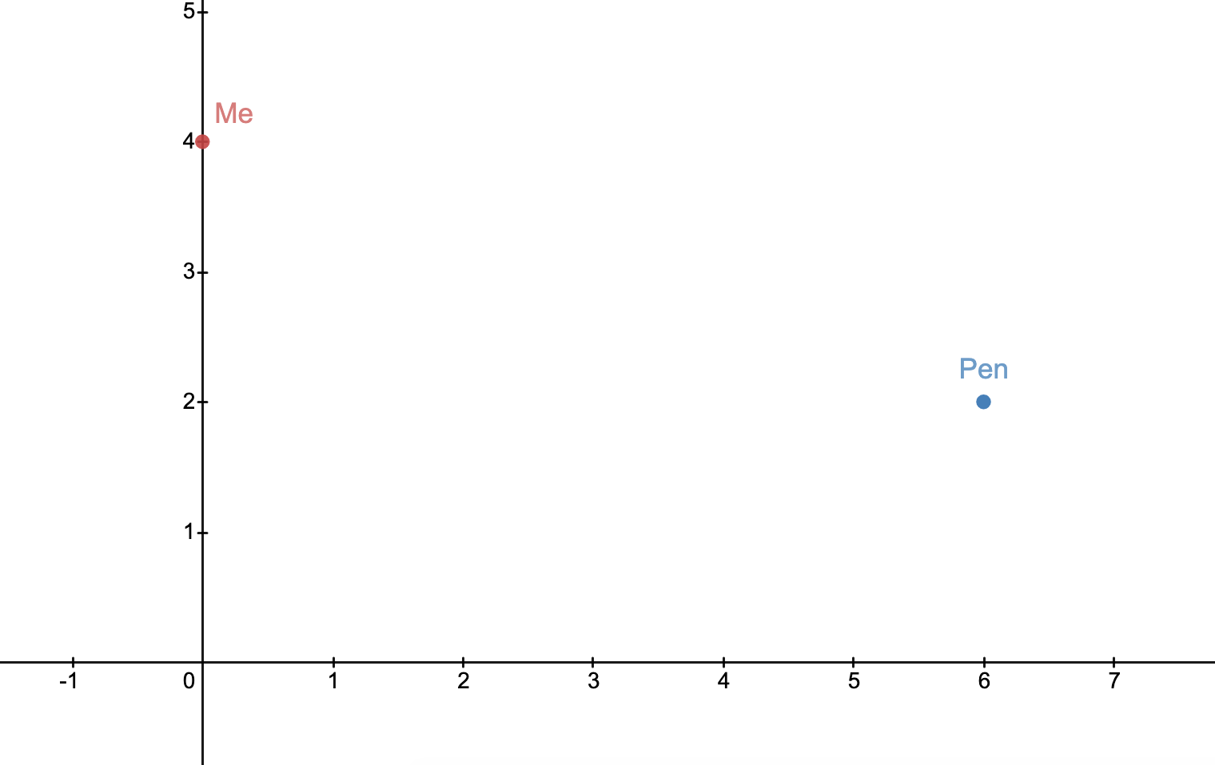

Slide 5
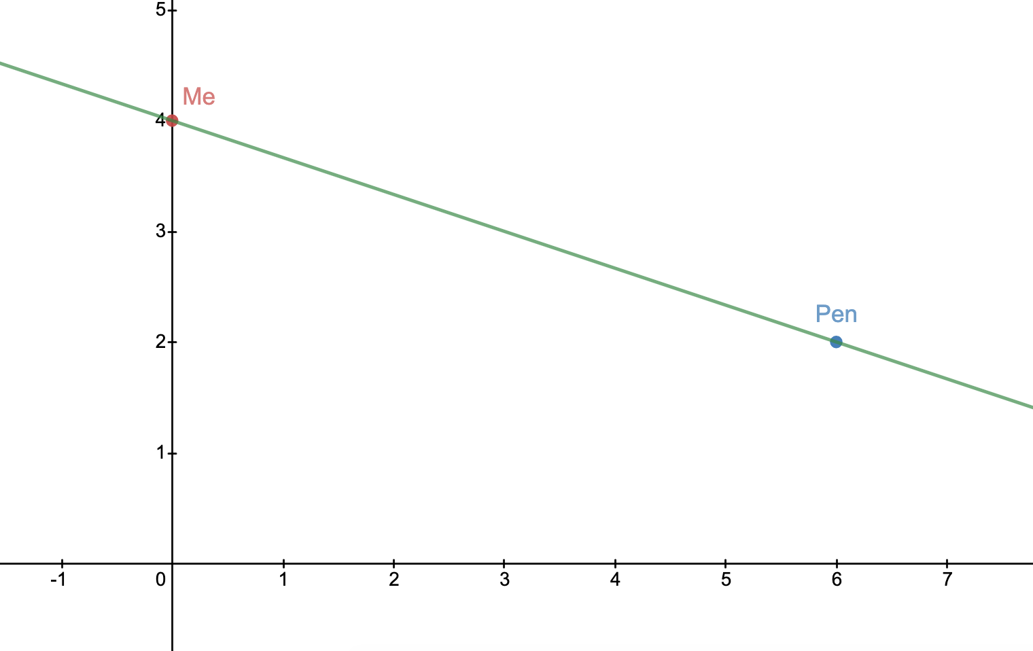

Slide 6
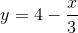

Slide 7
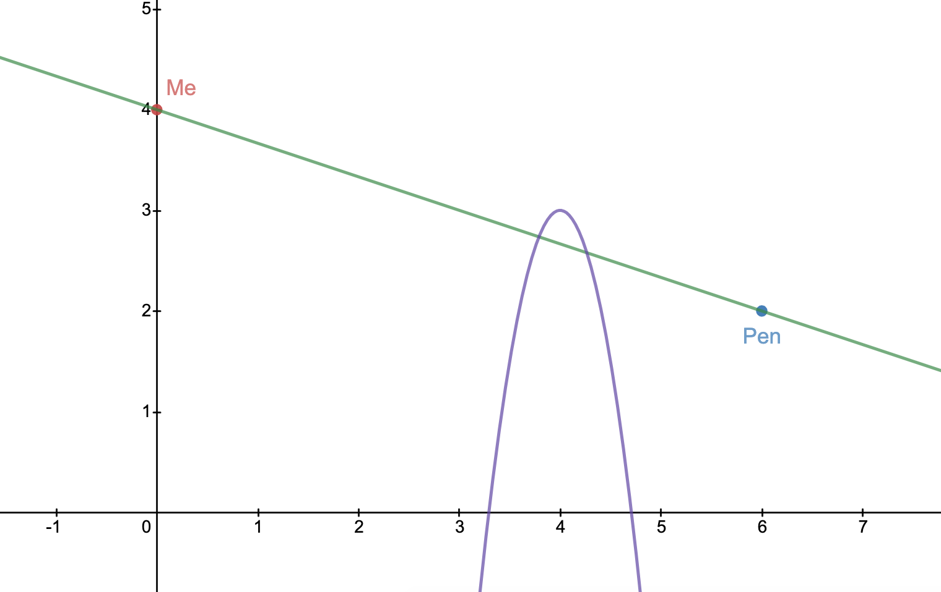

Slide 9

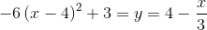
Setting the two Equal
Gives us values where the two functions intersect
In our case it does at x = 3.79, and x = 4.265
We can deduce that the line of sight is obstructed if the functions intersect anywhere in the Domain of the line of sight.
Our Domain being [0,6]

Slide 10
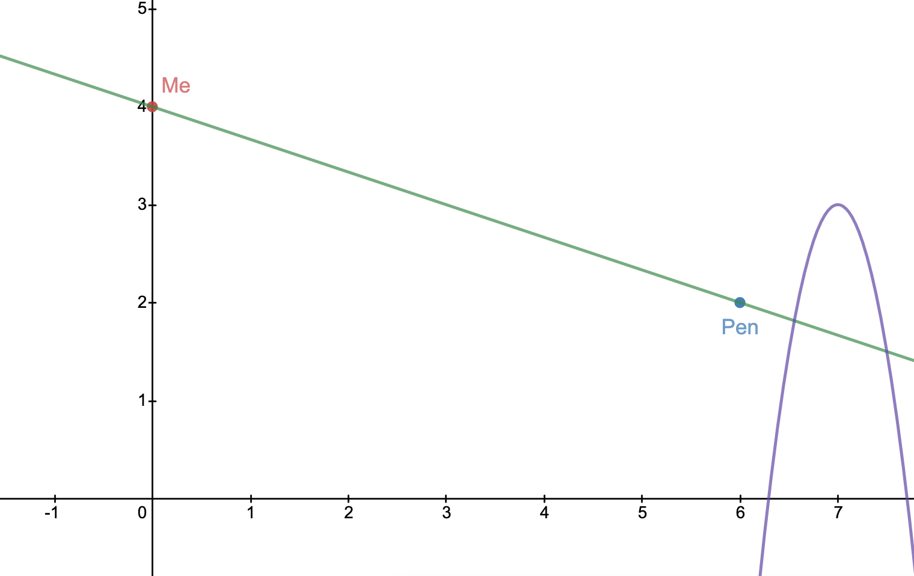

Slide 11
Connecting it back to Terrain Data
Start simple then make the model more complex or harder.
Reality of this model

Slide 12
What is a viewshed?
Viewshed would offer an unobstructed view from an observer point (also called a view source) to an object of interest (target) in any direction, where the target is coincident with the ground.
Constrained variables:
▪Height
▪Horizontal field of view
▪Azimuth
▪Pitch
▪Vertical field of view
Notes:
https://www.harrisgeospatial.com/docs/ViewshedAnalysis.html
An ideal viewshed would offer an unobstructed view from an observer point (also called a view source) to an object of interest (target) in any direction, where the target is coincident with the ground. However, observer points are often constrained by variables such as:
Height: The height (in meters) of the observer point
Horizontal field of view: The angle (in degrees) of the horizontal range of the observer point.
Azimuth: The angle (in degrees) clockwise from North. It sets the horizontal orientation of the observer point.
Vertical field of view: The angle (in degrees) of the vertical range of the observer point.
Pitch: The verticle pointing angle (in degrees) of the observer point's line of sight. A positive pitch value is above the horizon, and a negative pitch value is below the horizon.

Slide 13
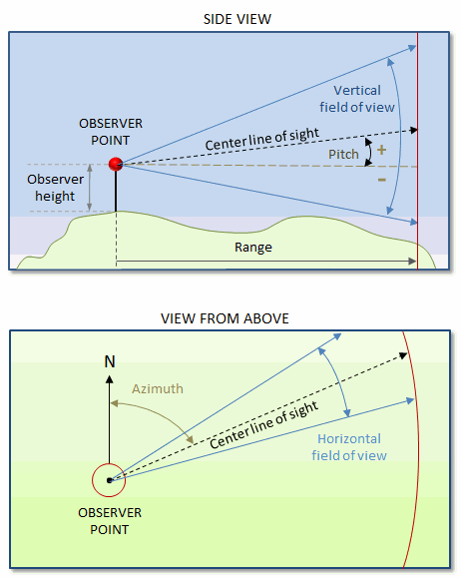
Visual Representation of Viewshed
Notes:
https://www.harrisgeospatial.com/docs/ViewshedAnalysis.html

Slide 14
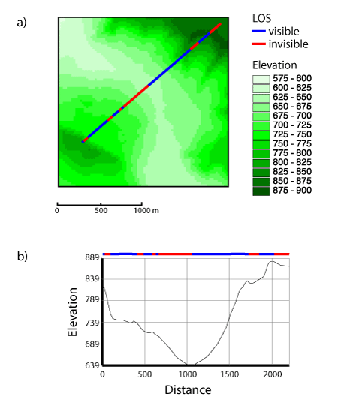
Line of sight: Grid
Notes:
A line-of-sight check requires a terrain profile between a viewpoint and a target point.
An LOS check is performed for each new vertex inferred.
The computation can be terminated as soon as an LOS blockage is found or the target point is reached.
For a viewshed analysis the LOS between the viewpoint and each other point has to be tested
and is therefore quite demanding. There are examples for a line-of-sight and an entire viewshed
in the next two figures.

Slide 15
How Can This Be Used in Real-Life Applications?
Notes:
Communications (cell towers, television towers, wind turbine, wireless network )
Architecture/Design (lighting)
Security (camera placement and range)
Uses of Line of Sight in GIS
Line of sight is an important analysis tool in many fields.
For example,
a developer may use line of sight to determine the best place to site a house on a hillside in order to create the best view of the ocean. The telecommunications industry uses visibility analysis to best site cell phone tower locations which need to have an unobstructed view of other cell phone towers for transmission purposes. For military purposes, line of sight is used to understand optimal positions for battle. In law enforcement, line of sight analysis can be used to canvas a crime scene to search for witnesses.
https://www.gislounge.com/line-of-sight-in-gis/

Slide 16
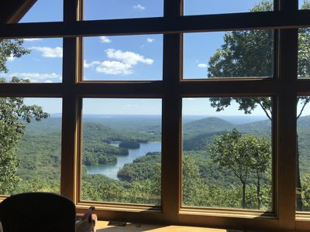
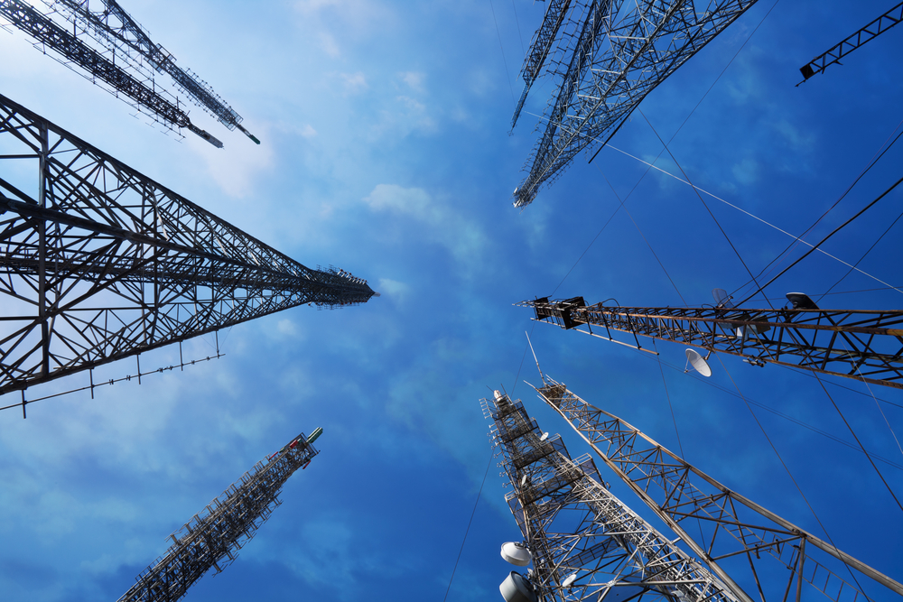
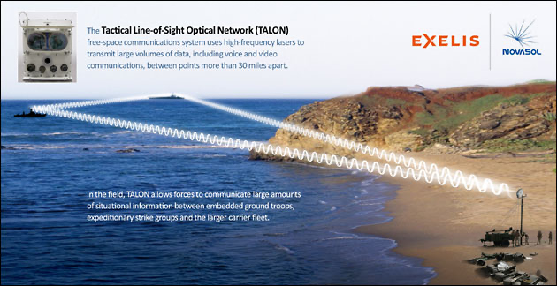

Applications
Notes:
Communications (cell towers, television towers, wind turbine, wireless network )
FM radio, microwave and satellite transmission are examples of line-of-sight communication.
For example, mobile phones use a modified line-of-sight transmission, which is made possible through a combination of effects like diffraction, multipath reflection, local repeaters and rapid handoff.
Architecture/Design (lighting)
Security (camera placement and range)
Uses of Line of Sight in GIS
Line of sight is an important analysis tool in many fields.
For example,
a developer may use line of sight to determine the best place to site a house on a hillside in order to create the best view of the ocean. The telecommunications industry uses visibility analysis to best site cell phone tower locations which need to have an unobstructed view of other cell phone towers for transmission purposes. For military purposes, line of sight is used to understand optimal positions for battle. In law enforcement,.
line of sight analysis can be used to canvas a crime scene to search for witnesses
https://www.photonics.com/Articles/Laser-Based_Communications_Passes_Military_Tests/a55391
https://whatsag.com/mobile-technology/what-is-a-cell-tower.php
The Cell Tower’s Range
There are places where we often see a lot of cell towers. If they are allowed to stand near one another, what could the range of each cell tower be?
The range of a cell tower in which mobile devices connects reliably to it is not a fixed figure and it may depend on some of these factors.
The height of the antenna over the surrounding landscape.
The frequency of the signal in use.
The rated power of the transmitter.
The directional characteristics of the antenna array on the site.
The absorption and reflection of radio energy by buildings or vegetation.
The local geographical or regulatory factors and weather conditions.
In those areas where there are enough cell towers to cover a wide area, the range of each one will be set to ensure that there is enough overlap from or to other sites and to ensure that the overlap area is not too large, to avoid interference problems with other cell towers or sites. Cell towers are usually grouped in areas with high population density or those places with the most potential users.
There are times when our mobile phones do not have a signal. It can be because we’re too far from a tower, or the cell phone signals in our location are decreased by thick building walls, hills, or other structures. The signals from a cell tower do not need a clear line of sight but a greater radio interference will eliminate reception. Also, when a lot of people try to use a cell tower at the same time such as during events, or in a traffic jam, there’s a tendency for the signal to be blocked.
The Viewshed tool shows the line of sight from any given placemark. The Google Earth help page lists some possible uses as:
FREE: To use Google Earth Pro, you need only use your email address with the License Key “GEPFREE.
https://www.digitaltrends.com/computing/how-to-get-google-earth-pro-for-free/
Checking the views from a house you plan to build.
Architects can analyze the views available from a tract of land before designing buildings.
Real estate agents can evaluate views remotely, and take views into consideration when they set property prices.
Businesses can make rough estimates of cell tower coverage from a particular location.
Advertisers can try out different locations for billboards and signs.
https://www.gearthblog.com/blog/archives/2015/02/google-earth-pro-viewshed-tool.html

Slide 17
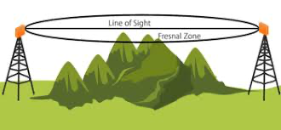
Visual LOS vs. radio LOS
Fresnel Zone
Ground, water RF reflections
Earth, atmosphere
Wireless obstructions
Notes:
https://www.controleng.com/articles/wireless-line-of-sight-non-line-of-sight-beyond-line-of-sight-propagation/

Slide 18
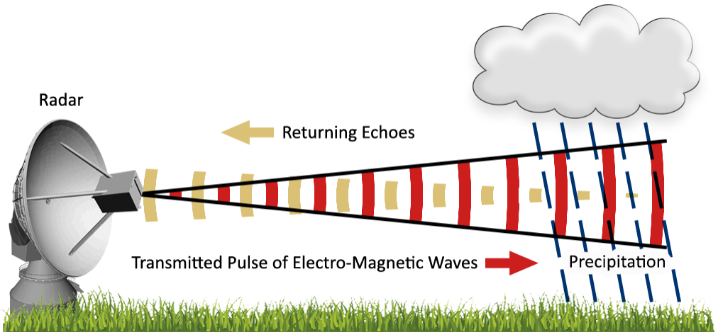
Notes:
How weather radar works, including visual representation of radar’s Line of Sight (RLOS).
https://savethehuronmountains.org/2018/09/14/overview-of-wind-turbine-interference-with-weather-radar/
Viewshed analysis has been used in a wide range of applications, including locating telecommunication relay towers (De Floriani et al., 1994), locating wind turbines (Kidner et al., 1999), protecting endangered species (Camp et al., 1997), analysing archaeological locations (Lake, M., et al., 1998), evaluating urban environment planning (Lake, I., et al., 1998) and optimal path route planning (Lee and Stucky, 1998).
https://core.ac.uk/download/pdf/1668904.pdf

Slide 19
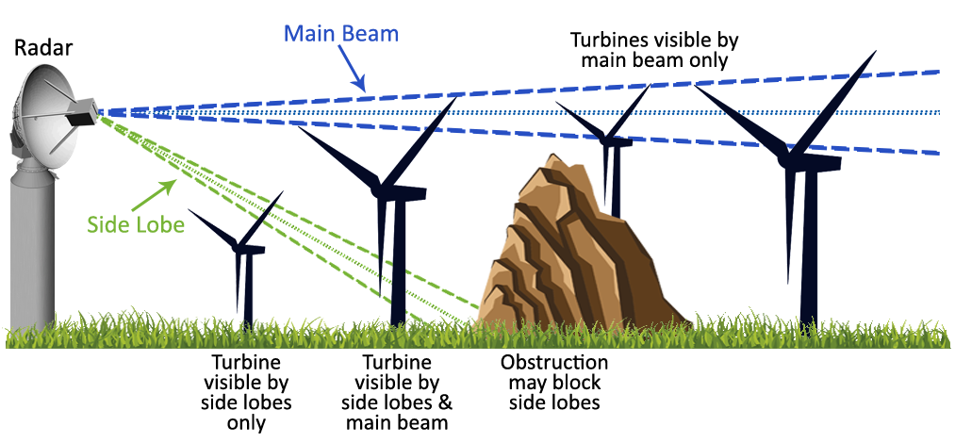
Wind turbine interference with weather radar
Notes:
https://savethehuronmountains.org/2018/09/14/overview-of-wind-turbine-interference-with-weather-radar/

Slide 20
Viewshed generator & antenna height (LOS)
ViewShed
Antenna
Notes:
https://www.scadacore.com/tools/rf-path/rf-line-of-sight/
http://wisptools.net/tools-viewshed.php

Slide 21
Goals
Create a map visualization using elevation data.
Create a viewshed for an observation point by combining all possible lines of sight.
Display the constructed viewshed on the map, in an understandable and interpretable manner.

Slide 22
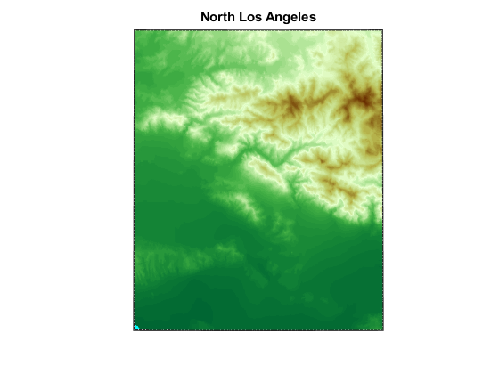
Terrain Data: North Los Angeles
Elevation data represented in a 2-D format is a useful place to start in terms of visual understanding.
From lowest to highest, the elevation goes from green to white to brown.
Notes:
Shown above is terrain elevation data of the Northern LA basin and Angeles National Forest. This is a 2-D visualization, to be used as a starting point for visualizing the data. Green represents the lowest elevations, and brown the highest.

Slide 23
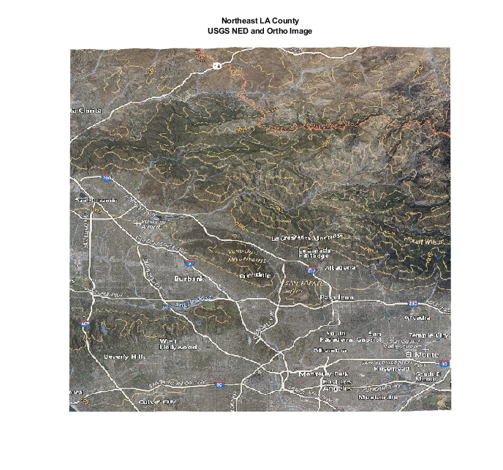
Creating a 3-D Map
The same area of LA is displayed in 3-D.
Satellite imagery from the USGS makes it possible to identify man-made boundaries and routes, such as city limits and freeways.
Notes:
On the left, the same area of Los Angeles is now displayed in 3-D. Satellite imagery from the US geological survey was draped over the model. This helps add realism and context to it, and makes the 3-D model easier to interpret from a mapping perspective.

Slide 24
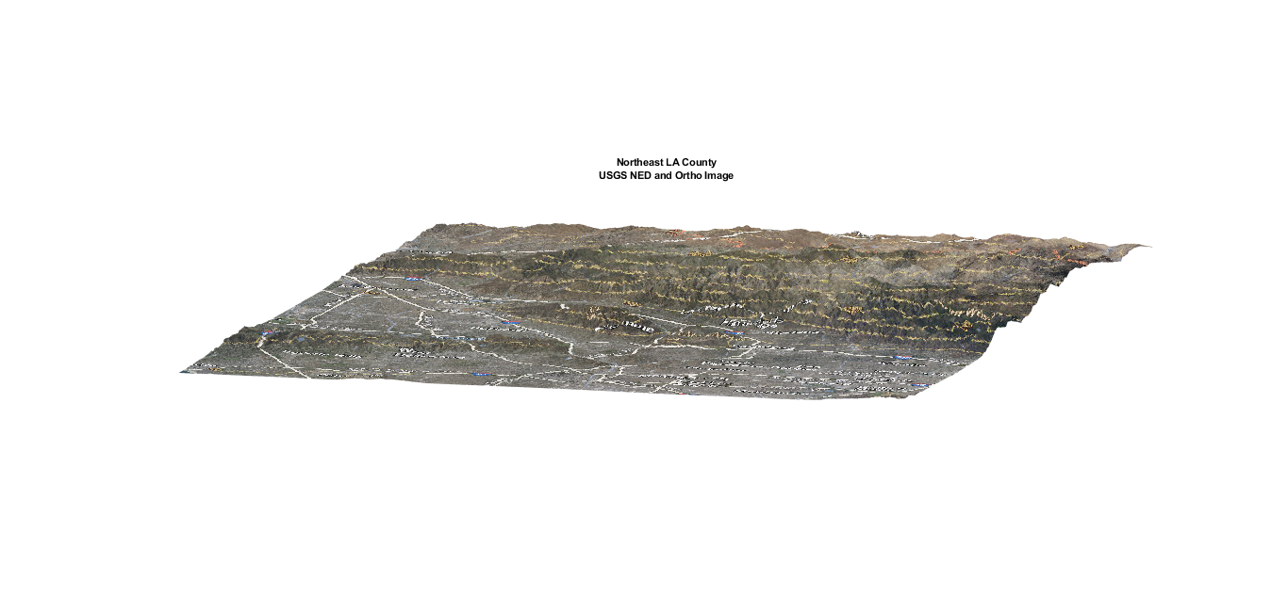
Creating a 3-D Map
Notes:
Here, a lower camera angle of the same figure is shown in order to emphasize the 3 dimensional aspect. Because the area being represented is so large (46.19km by 55.46km), the vertical changes in the map seem less significant than they really are. For example, even though this map actually looks really flat, its maximum and minimum elevations differ by 2133 meters, or around 7,000 feet.

Slide 25
Creating a Viewshed
In MATLAB, the viewshed() function tests each point’s line of sight from the observation point, and returns 1 if clear or 0 if obscured.
How does it do this?

Slide 26
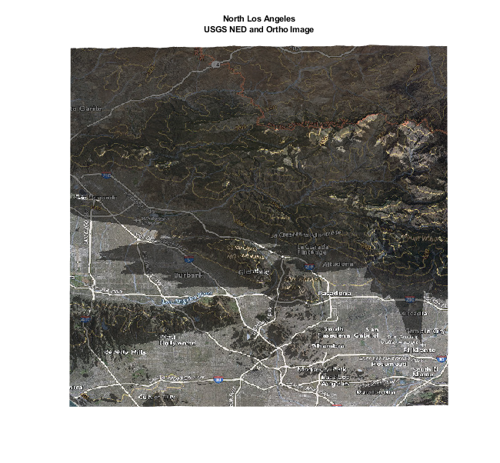
Applying a Viewshed to a Map
Observer point for viewshed
Any areas with an obstructed line of sight from the observation point are darkened, in order to show how the viewshed appears on a map.
Notes:
A viewshed based on the indicated point was then created. (the point used is Mount Wilson, which is a real-life location for multiple television towers servicing the Los Angeles area) Any areas that have an obstructed line of sight from the observation point (a.k.a. areas outside the viewshed), are darkened in order to show the viewshed’s shape. In other words, anything the light touches is part of your viewshed. It’s like the Lion King, but for terrain modeling.

Slide 27
A Changing Viewshed
How does line of sight change due to potential obstructions, temporary (storms, aircraft) or permanent (growing trees, new buildings)?
How does the viewshed change when the observation point changes?
Notes:
Line of sight can be blocked by obstructions anywhere along the path. Some obstructions can be temporary, like storms or aircraft. However, the more concerning type tend to be permanent objects, like a growing tree or a newly constructed building that blocks a previously clear line of sight. Each observation point has a unique viewshed, and therefore an object’s viewshed would change if it was in motion.

Slide 28
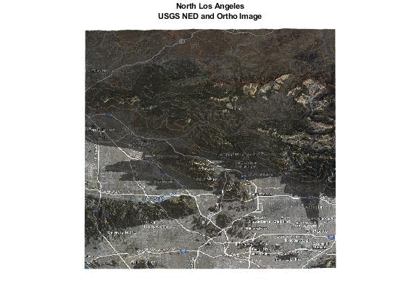
A Moving Observation Point, Visualized
The observation point from earlier was taken, and moved southwest in 1/1200 degree (≈20 m) increments.
As the observation point moves southwest down the mountain, the lower elevation causes many lines of sight to be blocked, shrinking the viewshed.

Slide 29
In Summary...
Line of sight: The line between an observation/transmitting point and a viewed/receiving point, which can be either clear or obstructed.
Viewshed: The collection of all possible clear lines of sight from a given observation point.
Line of sight calculation can have real world consequences that affect human lives.
Viewsheds and the visibility of their individual lines of sight can be calculated in software like MATLAB.
A moving observation point changes the shape of the corresponding viewshed.

Slide 30
References
https://www.merriam-webster.com/dictionary/line%20of%20sight
https://gisgeography.com/line-of-sight-viewshed-visibility-analysis/
https://www.harrisgeospatial.com/docs/ViewshedAnalysis.html
https://www.campbellsci.com/blog/line-of-sight-more-than-meets-eye
http://www.webgis.com/terraindata.html
https://www.mathworks.com/help/map/retrieve-data-from-web-map-server.html
https://www.mdpi.com/2220-9964/4/4/2769/html
https://www.scadacore.com/tools/rf-path/rf-line-of-sight/
http://wisptools.net/tools-viewshed.php
Notes:
post all the links from earlier here at the end

Slide 31
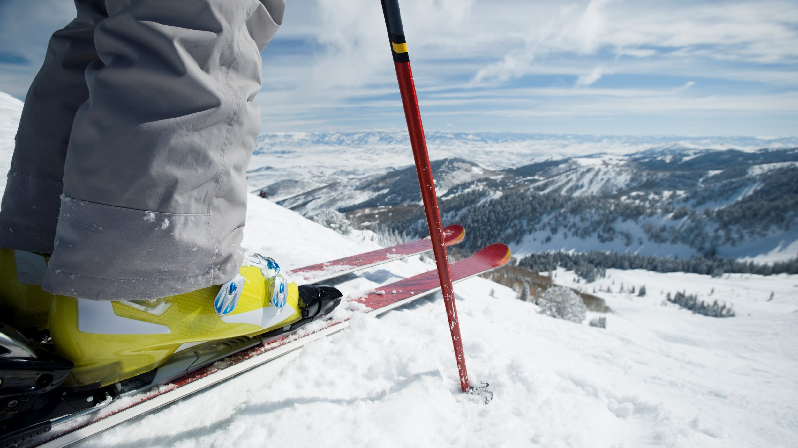
Thank You
◤

